Slide 1

WIS 2.0 Training Workshop, Windhoek, Namibia, 20-24 March 2023​
WIS2 in a box project and installation
Tom Kralidis
Senior Geospatial Architect
Meteorological Service of Canada
tom.kralidis@ec.gc.ca
@tomkralidis

Slide 2
Table of Contents
Git overview
GitHub overview
WIS2 in a box on GitHub
WIS2 in a box Tour
WIS2 in a box Components

Slide 3

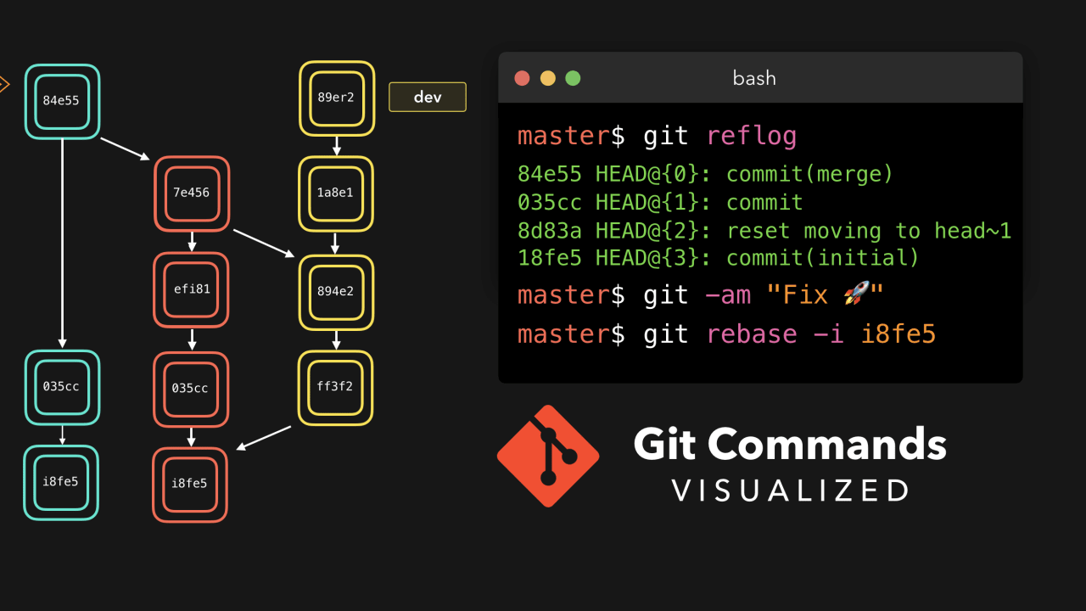
Git Overview
Git is a version control system originally developed for software / code management

Slide 4
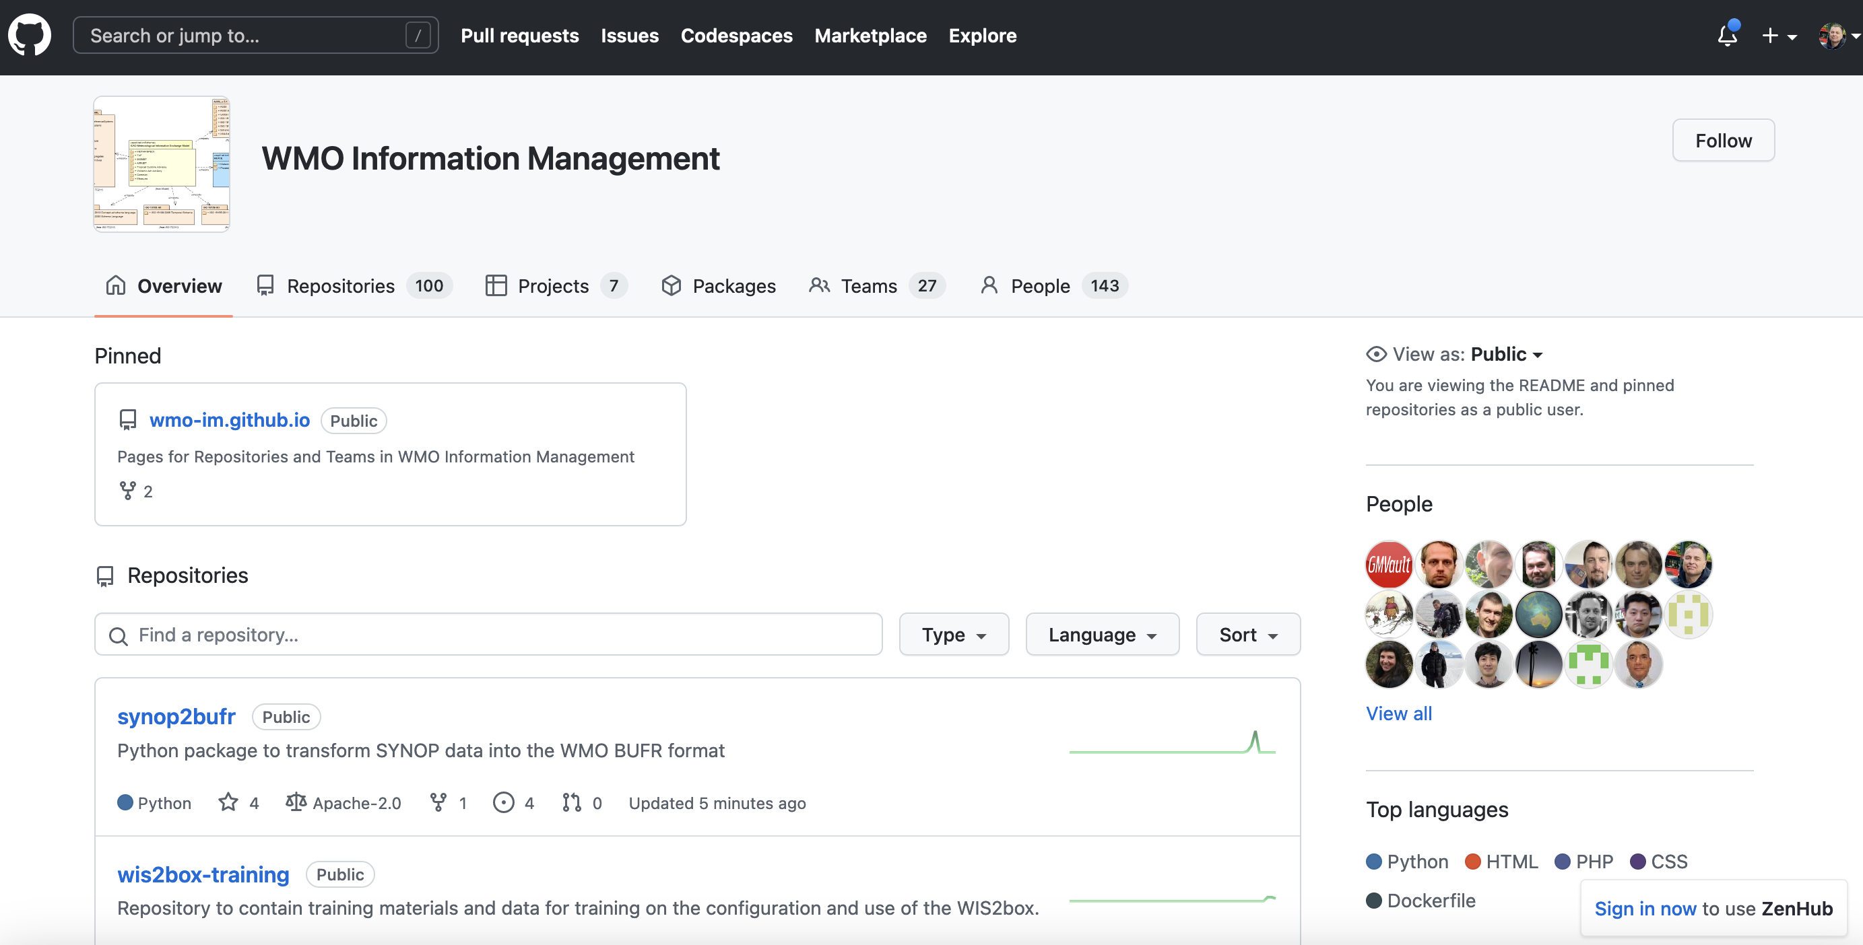
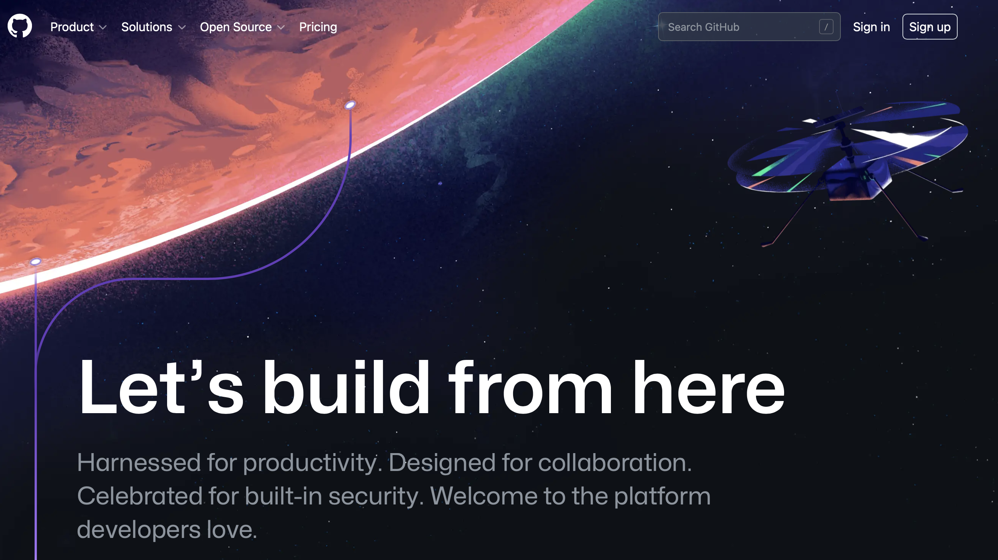

GitHub Overview
GitHub is a hosting service for software development using Git
Software / source code
Issues/bugs
Documentation
Automated testing
Used by numerous organizations (including WMO)

Slide 5
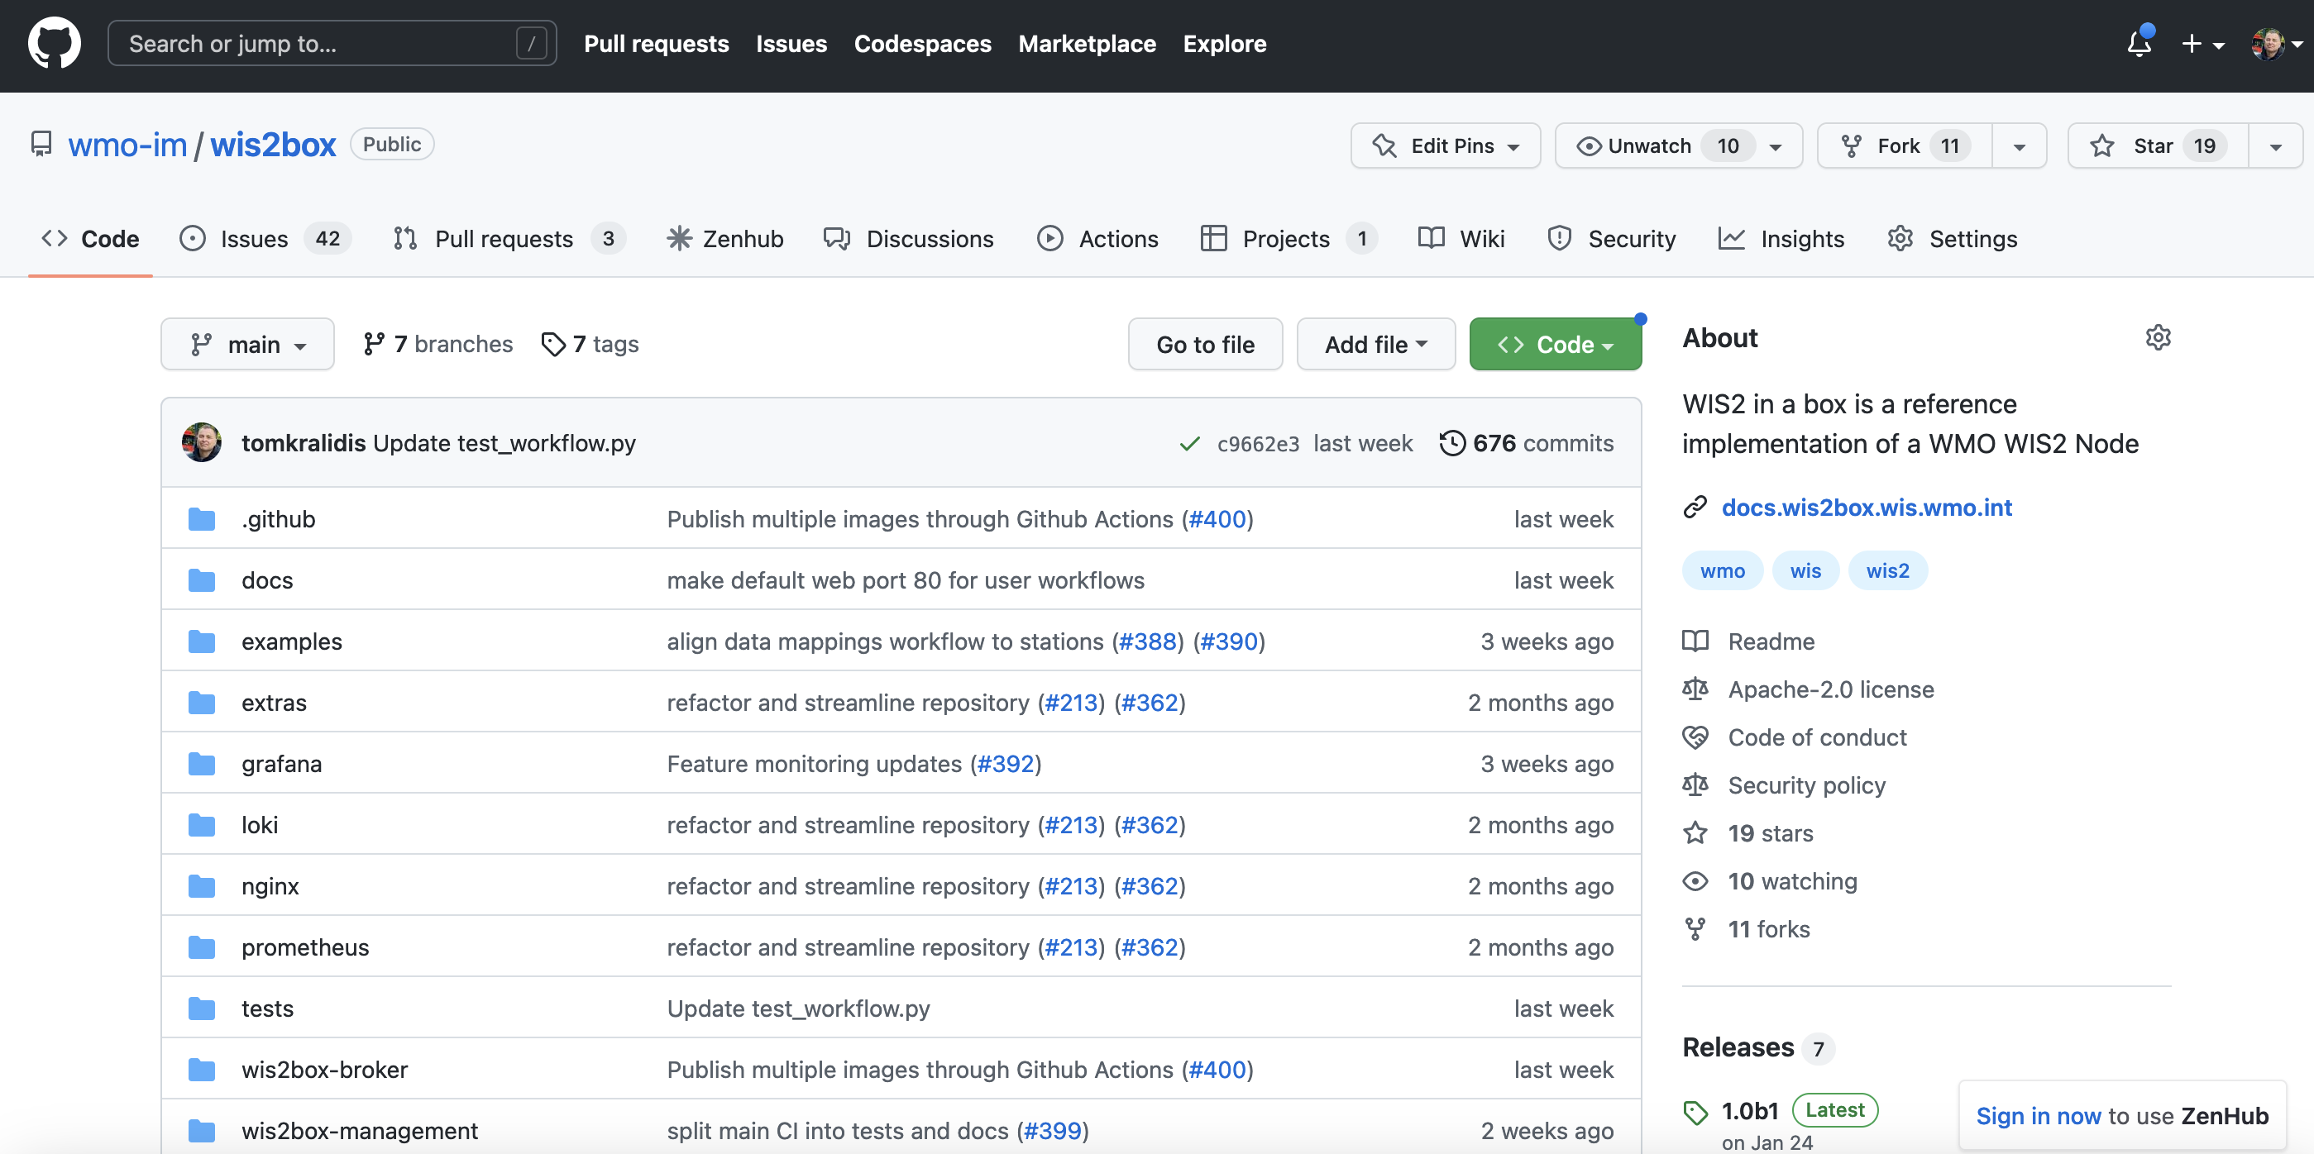
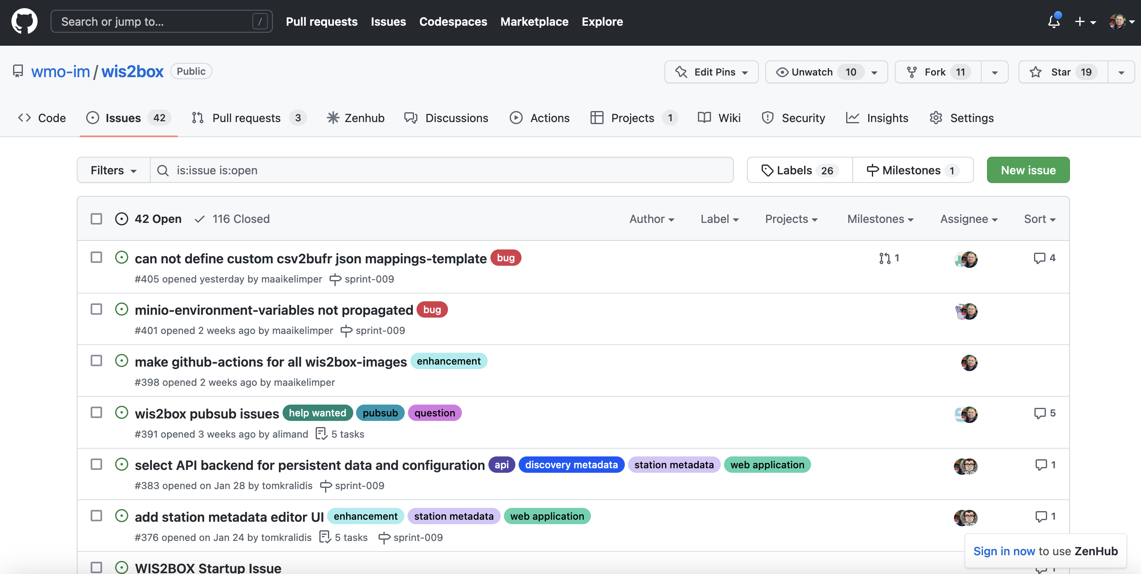
WIS2 in a box on GitHub
Software
Issue tracker
Releases
Automated testing
Discussions
github.com/wmo-im/wis2box

Slide 6
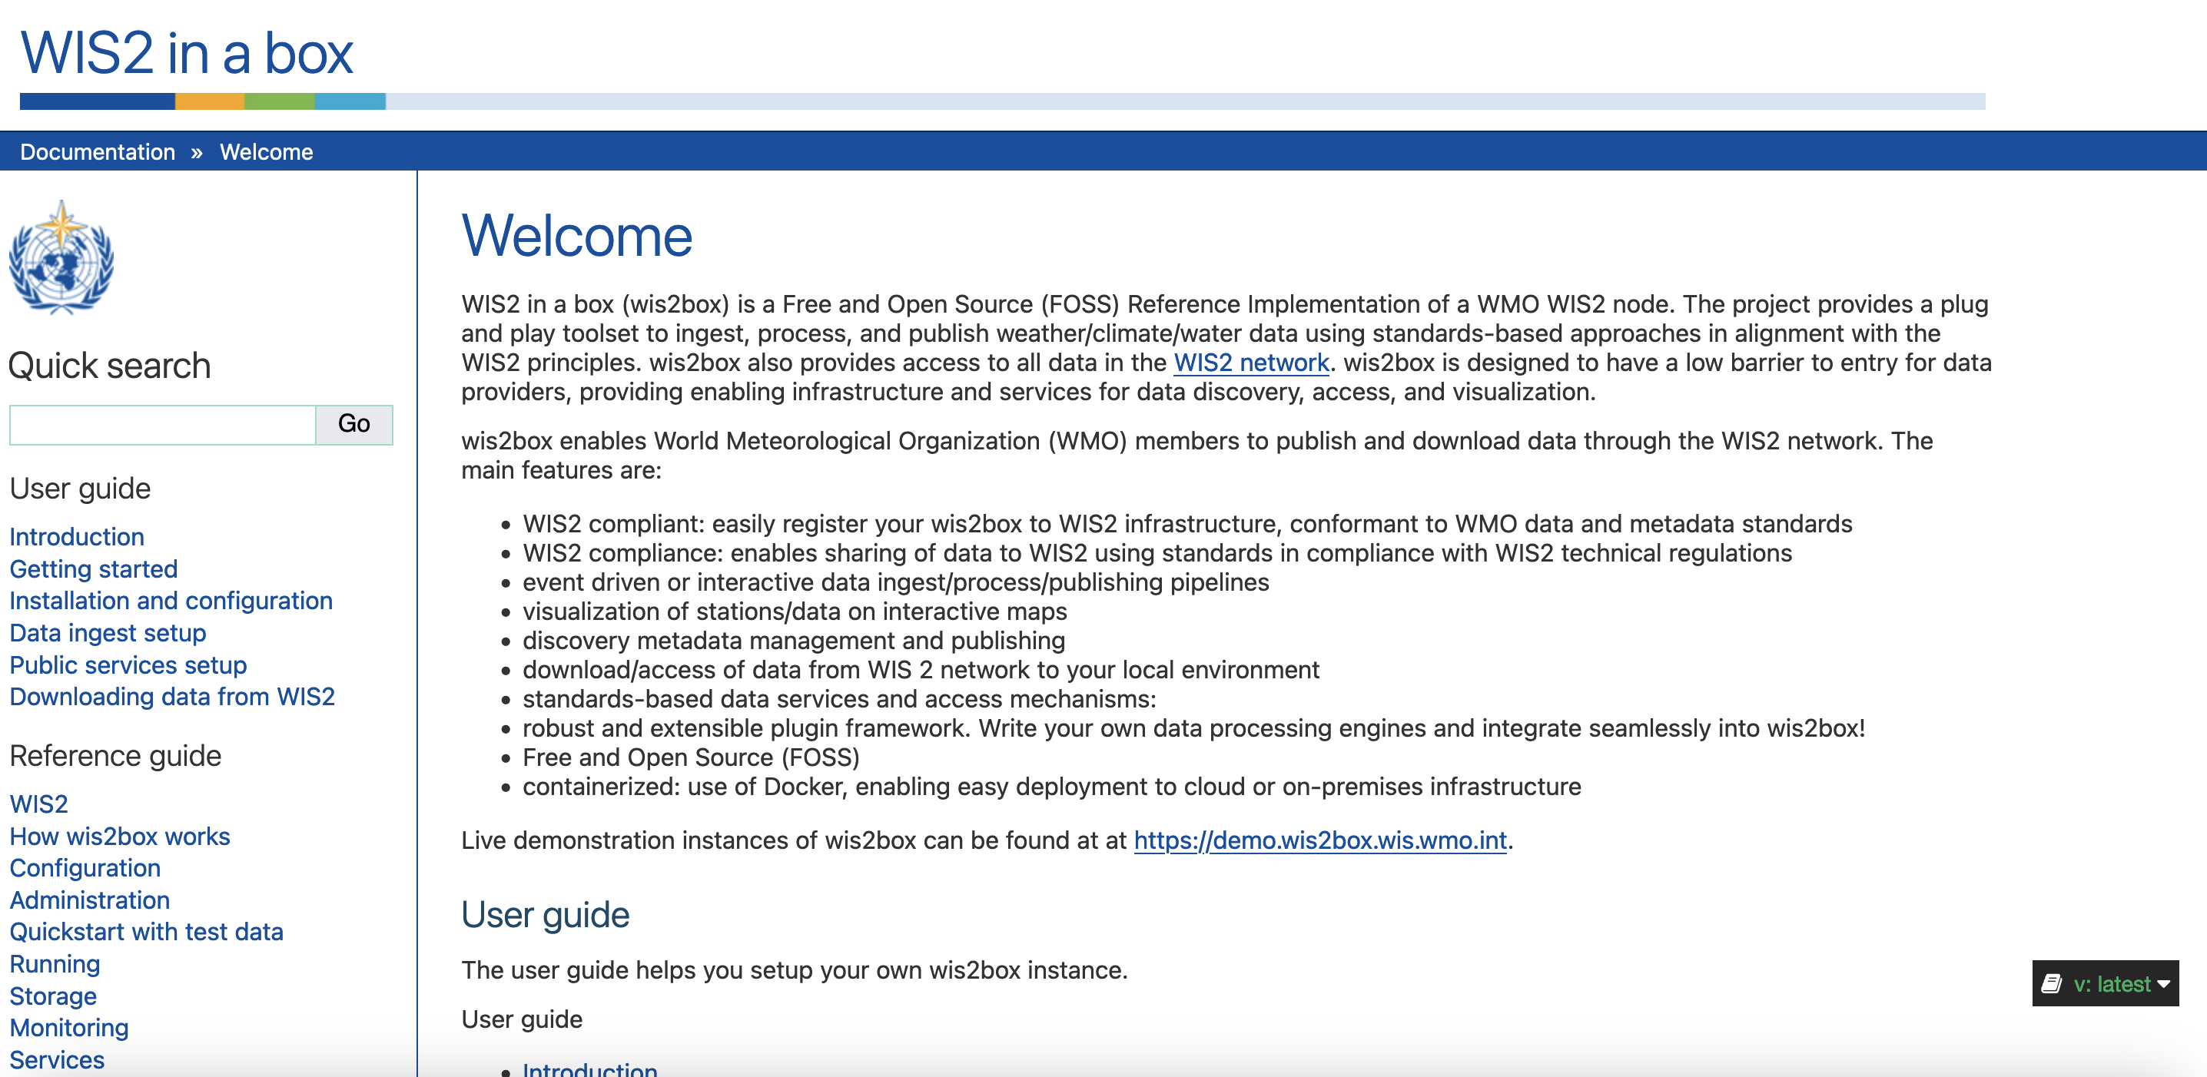
Documentation

Slide 7
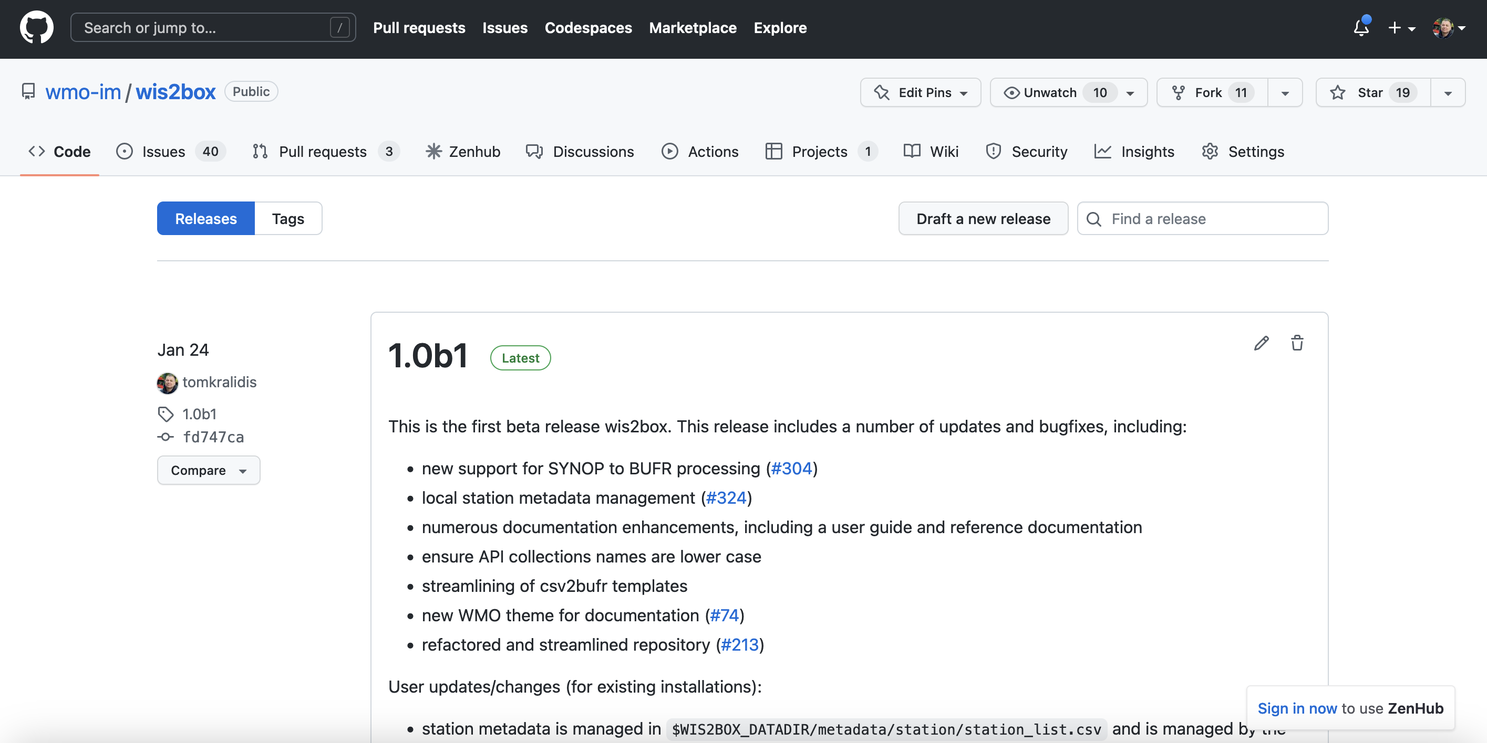
Releases

Slide 8
Code

Slide 9
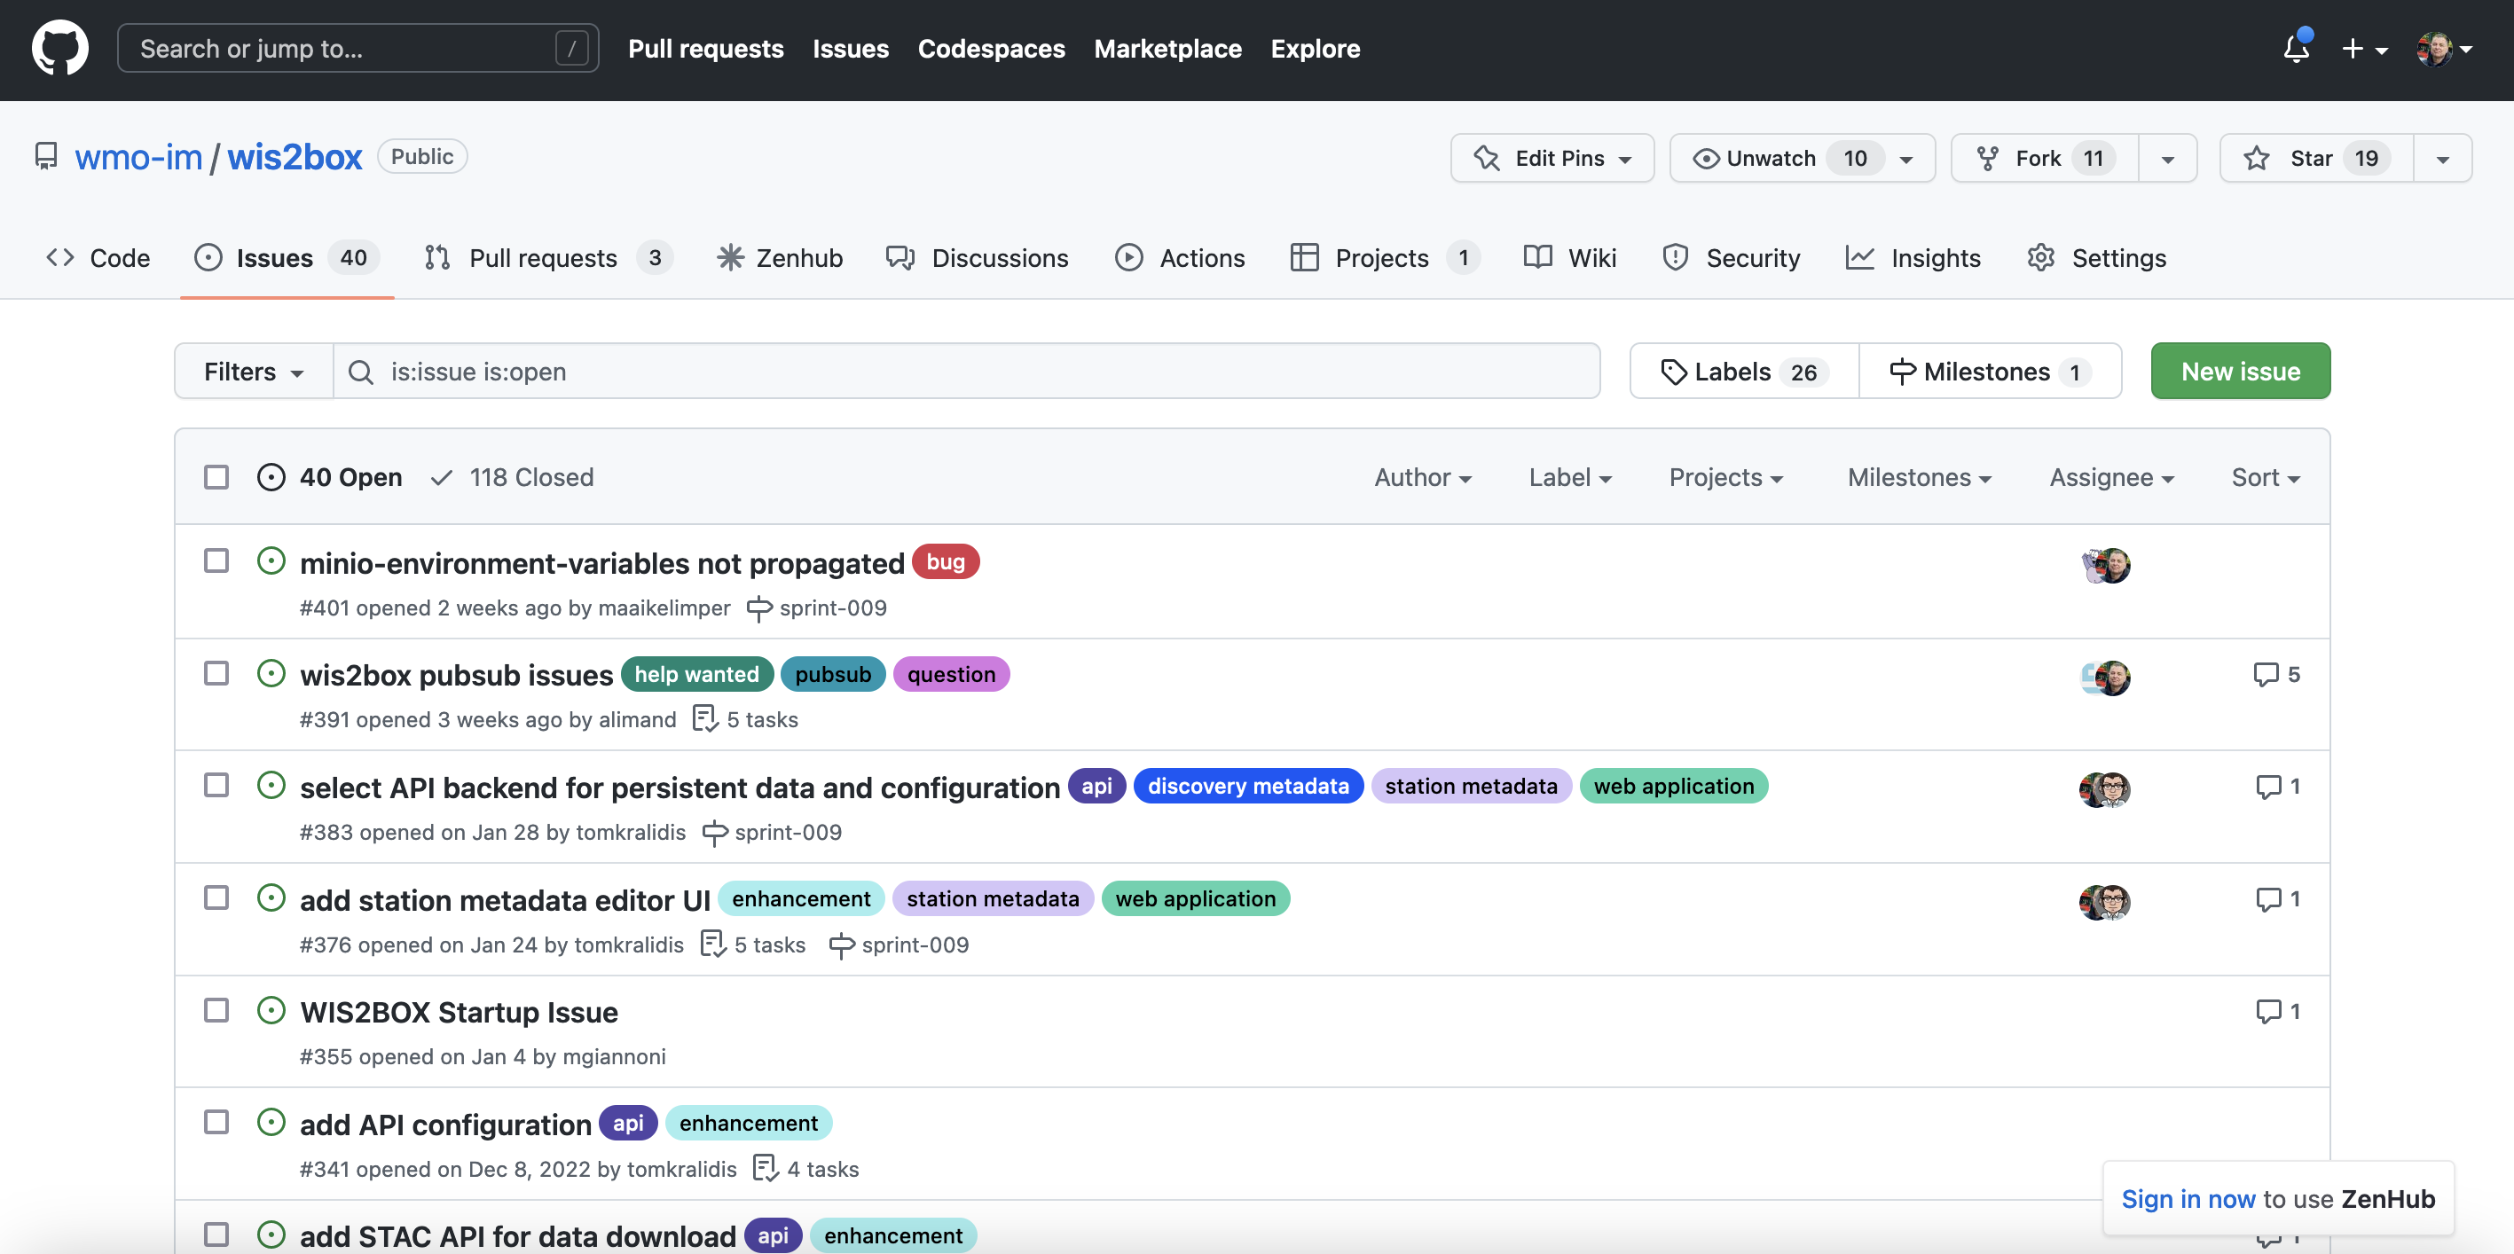
Issue tracker

Slide 10
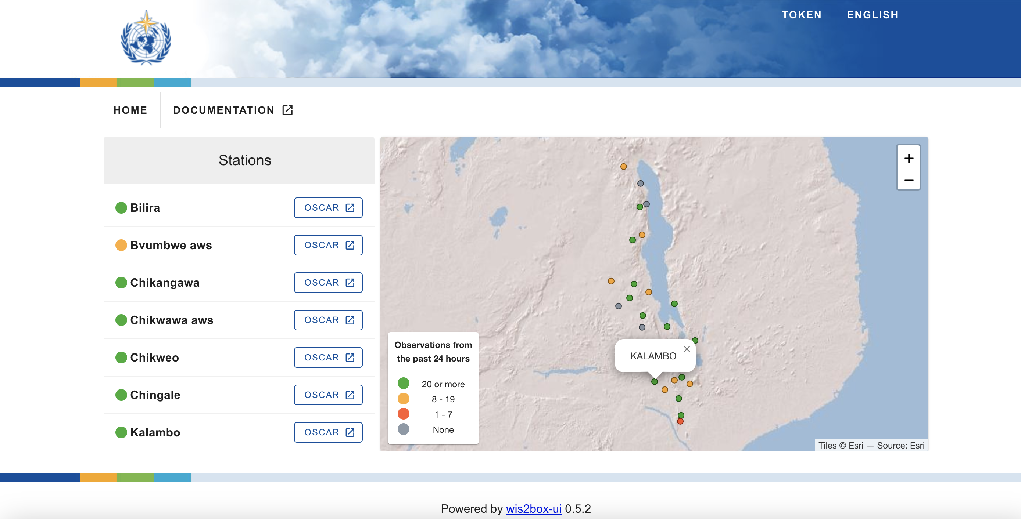
WIS2 in a box tour
Live demo

Slide 11
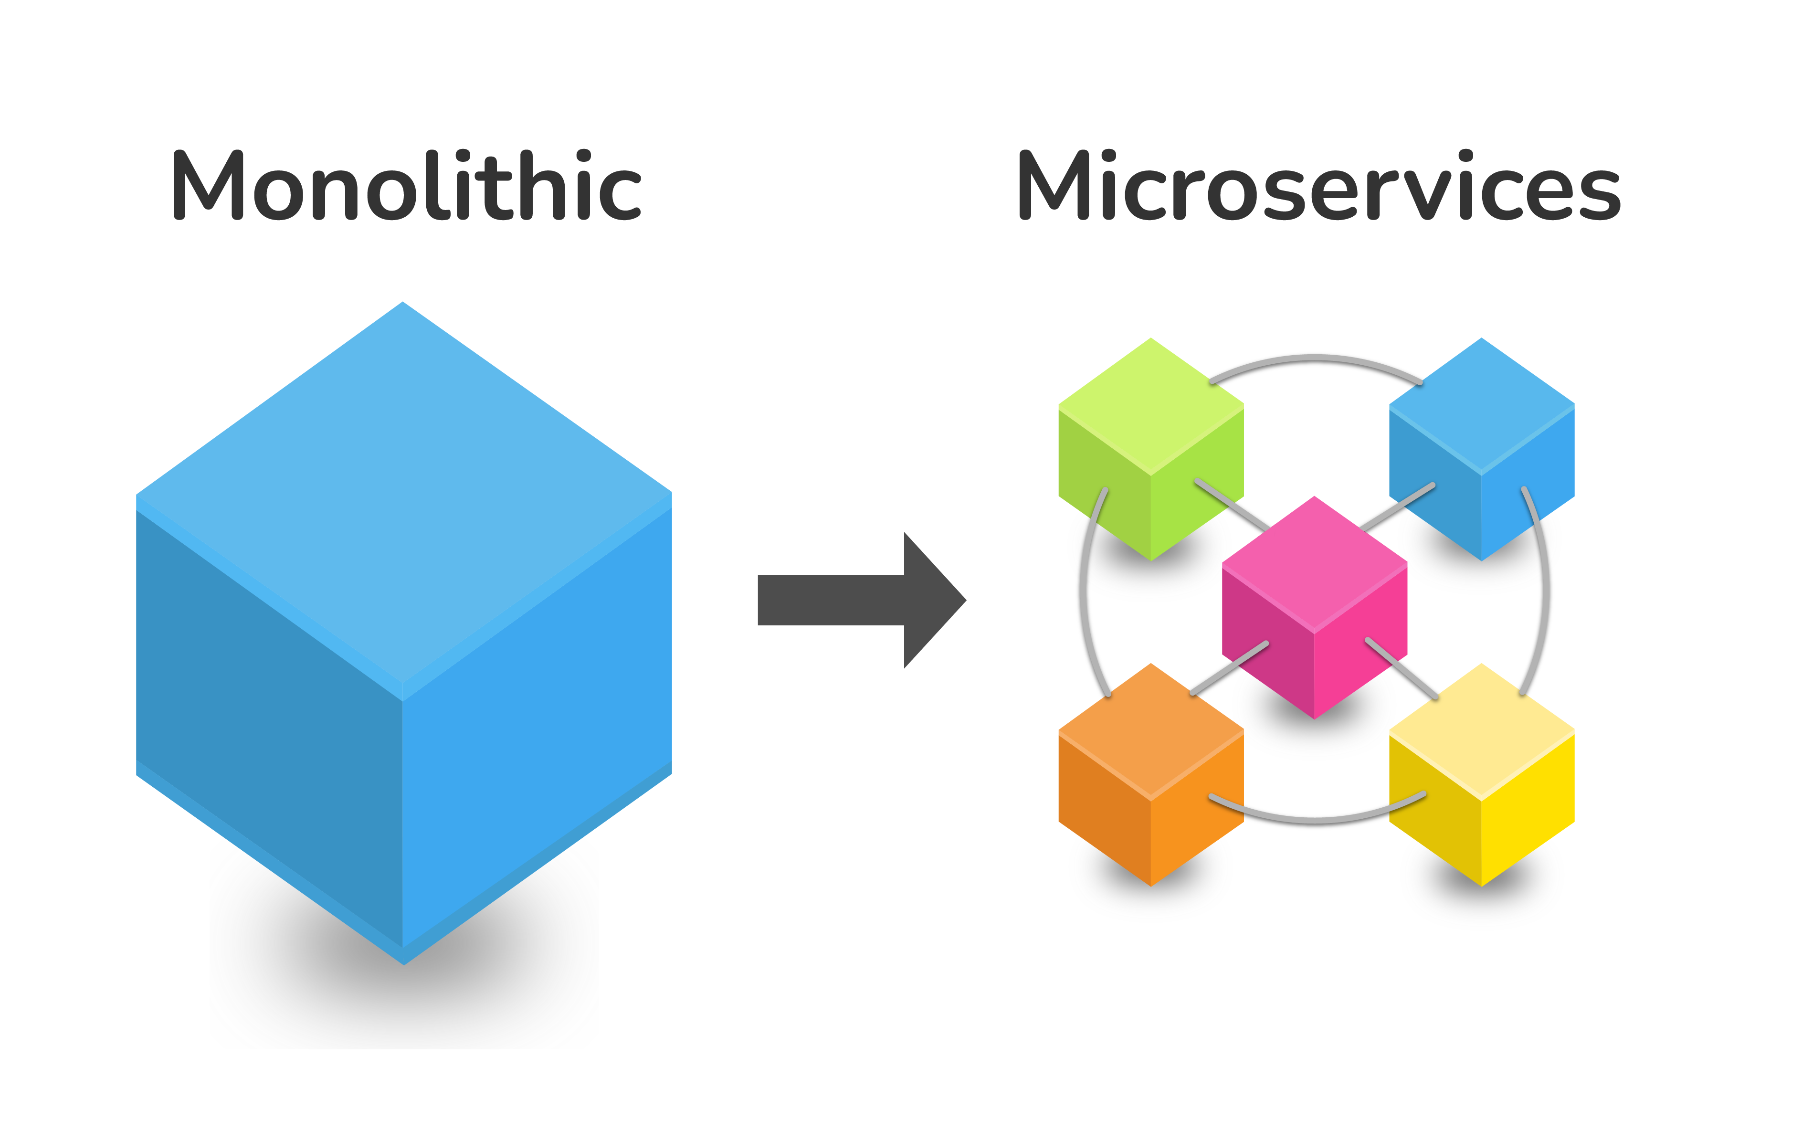

Docker
wis2box uses Docker for application management
Containerization
Microservices
Building blocks

Slide 12
WIS2 Components
Component | Technology | Docker Container
Storage | MinIO | wis2box-minio
Broker | mosquitto | wis2box-broker
Management | Python | wis2box-management
API | pygeoapi | wis2box-api
Web Application | Vue.js/LeafletJS | wis2box-ui
Metrics | Grafrana/ Prometheus/Loki | grafana

Slide 13
Installation
Installing wis2box

Slide 14

Thank you
Merci
Gracias
شكرا
谢谢

